Slide 1
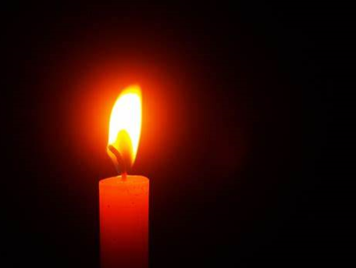
We light this candle in the name of God the Father, God the Son and God the Holy Spirit.

Slide 2


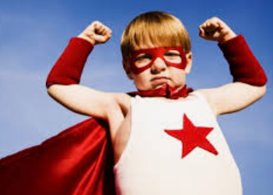
Today we’re going to be thinking about how we can be ‘agents of change’

Slide 3

What do agents of change do?
Agents of change look at things in the world that are unfair or wrong and they do what they can do make a change and turn the situation around.

Slide 4
How might they make a change?
Write to the companies involved
Raise awareness of the situation
Get involved and do something active to make a difference
Raise money
Write a letter to local MP

Slide 5

a
Engage…
Let’s look at what’s in the world…

Slide 6
Watch:
First:
How Do You Explain Black History Month to Kids? – YouTube
Then:
Doll test - The effects of racism on children (ENG) - YouTube

Slide 7

a
Respond
Reflect on what you have heard. How does it make you feel?

Slide 8

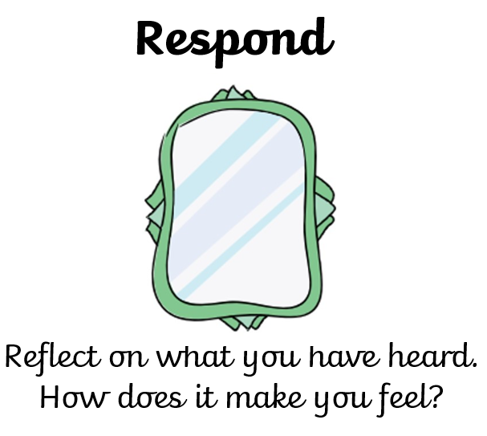

Slide 9
Is there anything that we can do to be agents of change in this situation?

Slide 10

a
Sending…
How will what you have heard today mean that you make a change?

Slide 11
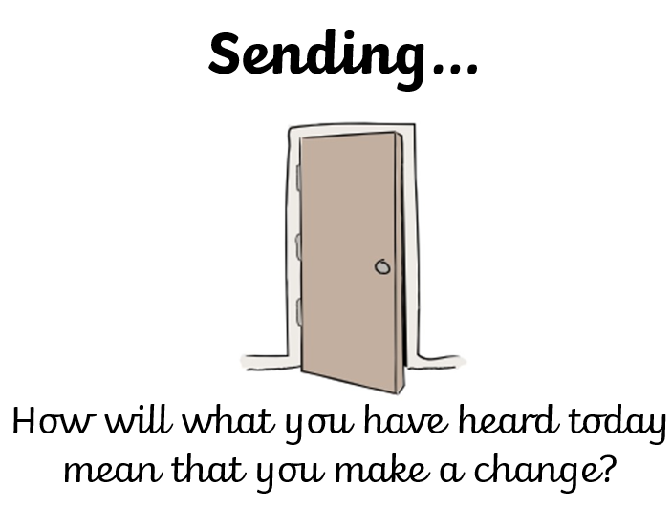
What can you do to share your gift of courageous advocacy and make a change this week?

Slide 12

An invitation to pray…
Who would like to pray about the situation that we have thought about today?

Slide 14

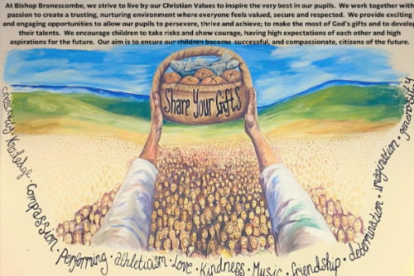
God be with you

