Slide 1
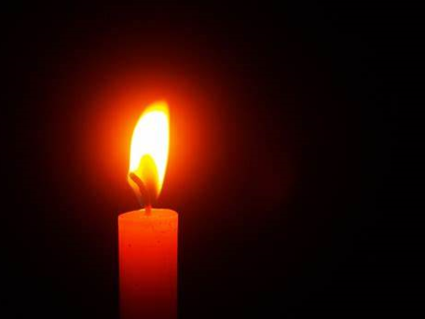
We light this candle in the name of God the Father, God the Son and God the Holy Spirit.

Slide 2


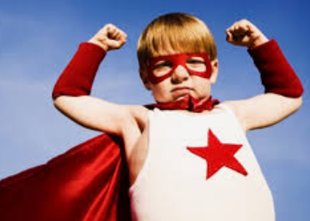
Today we’re going to be thinking about how we can be ‘agents of change’

Slide 3

What do agents of change do?
Agents of change look at things in the world that are unfair or wrong and they do what they can do make a change and turn the situation around.

Slide 4
How might they make a change?
Write to the companies involved
Raise awareness of the situation
Get involved and do something active to make a difference
Raise money
Write a letter to local MP

Slide 5


Do anyone know what ‘protected characteristics’ are?

Slide 6
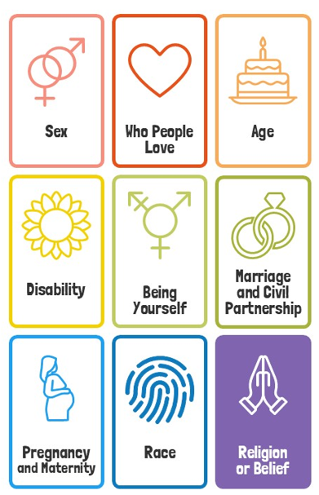
v
Protected characteristics are nine personal traits that make us who we are. Everyone has these traits, and it is illegal to treat anyone unfairly, unkindly, or differently because of them.

Slide 7
v
In our agents of change session today, we’re going to be thinking about this protected characteristic:

Slide 8

Watch: World cup players who got abused because they missed a penalty kick
And
Black players targets of racist attacks after England’s Euro Cup loss

Slide 9

Looking in

Slide 10
How does it make you feel to know that people get abused because of their race (colour of their skin)?
Looking in

Slide 11
Looking in
Is there anything that we can do to be agents of change in this situation?

Slide 12

a
How will what you have heard today mean that you make a change?

Slide 13
What can you do to share your gift of courageous advocacy and make a change this week?

Slide 14


An invitation to pray…
Who would like to pray about the situation that we have thought about today?
Looking up

Slide 16

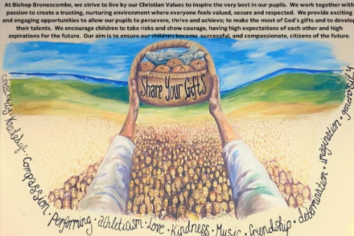
God be with you

