Slide 1
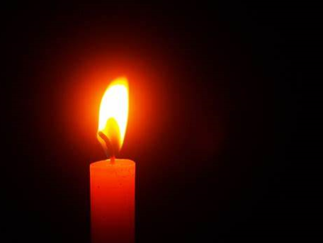
We light this candle in the name of God the Father, God the Son and God the Holy Spirit.

Slide 2

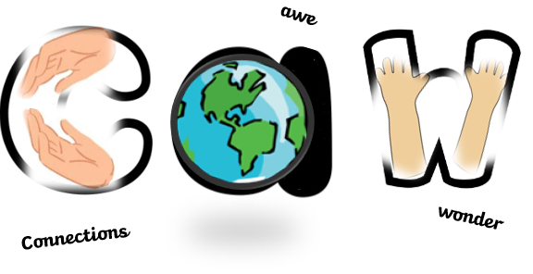
Today we’re going to ask ‘BIG questions’
Asking BIG questions…

Slide 3
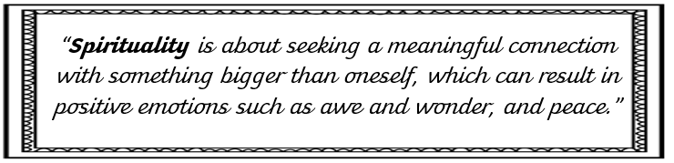
First of all, let’s remind ourselves of what Spirituality is for us at BB:

Slide 4
Asking big questions helps us to ‘make connections’ because we’re finding out more about something bigger than our selves.
Asking BIG questions…

Slide 5

a
Engage…
Let’s look at what’s in the Bible or the world…

Slide 6
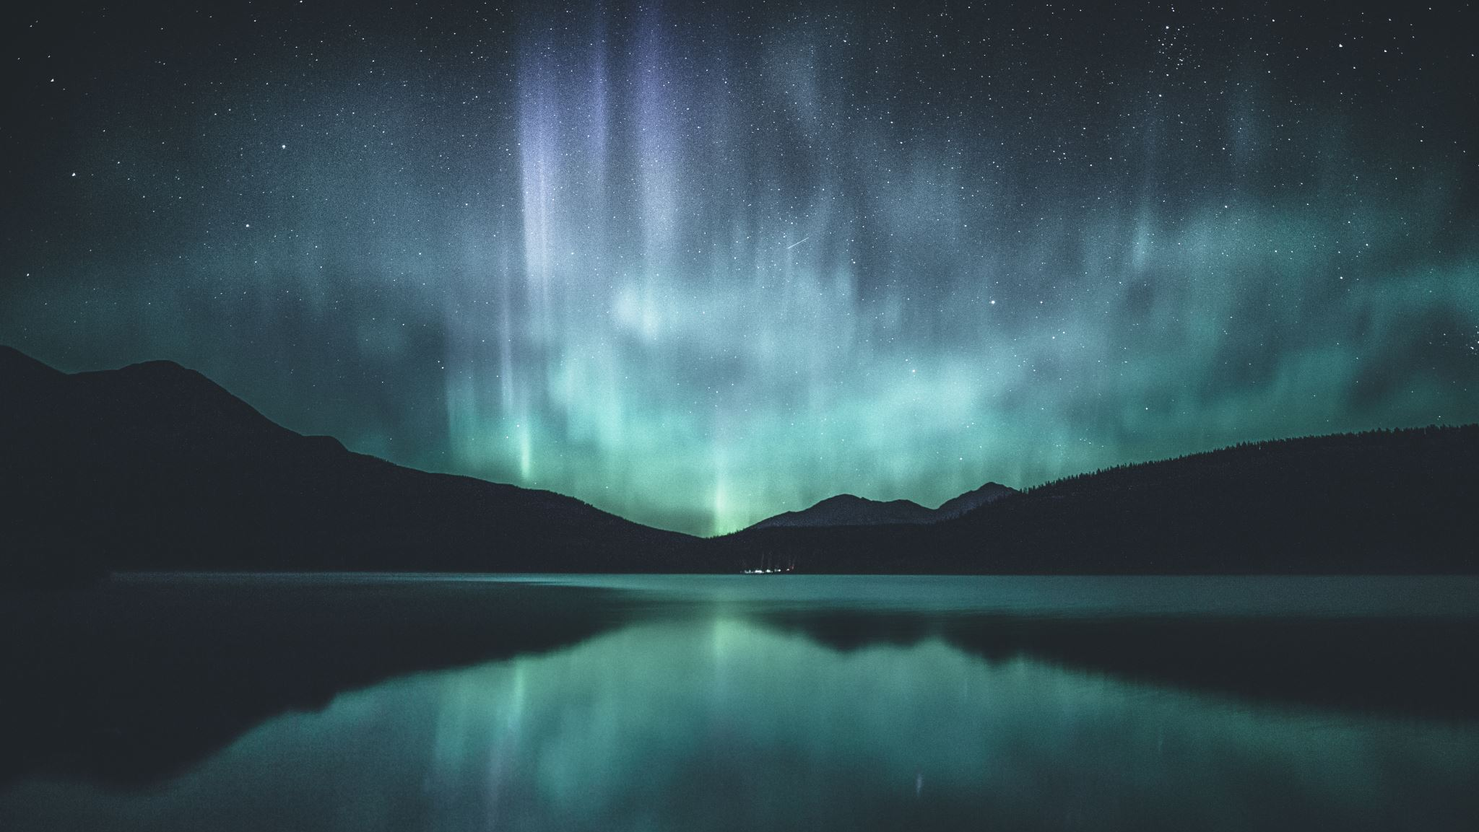
In our world, there are ‘natural wonders’. These are places/things that happen naturally that make people go ‘CAW!’
The first one that we are going to focus on is ‘Aurora Borealis’ otherwise known as ‘The Northern lights.’ https://www.youtube.com/watch?v=71lFlJDQE54

Slide 7
When watching that clip, did you think
“CAW!! The Northern lights are awesome!”?
If you did, you’ve just experienced a moment of awe and wonder! Maybe looking at all of the colours changing made you feel peaceful too?

Slide 8
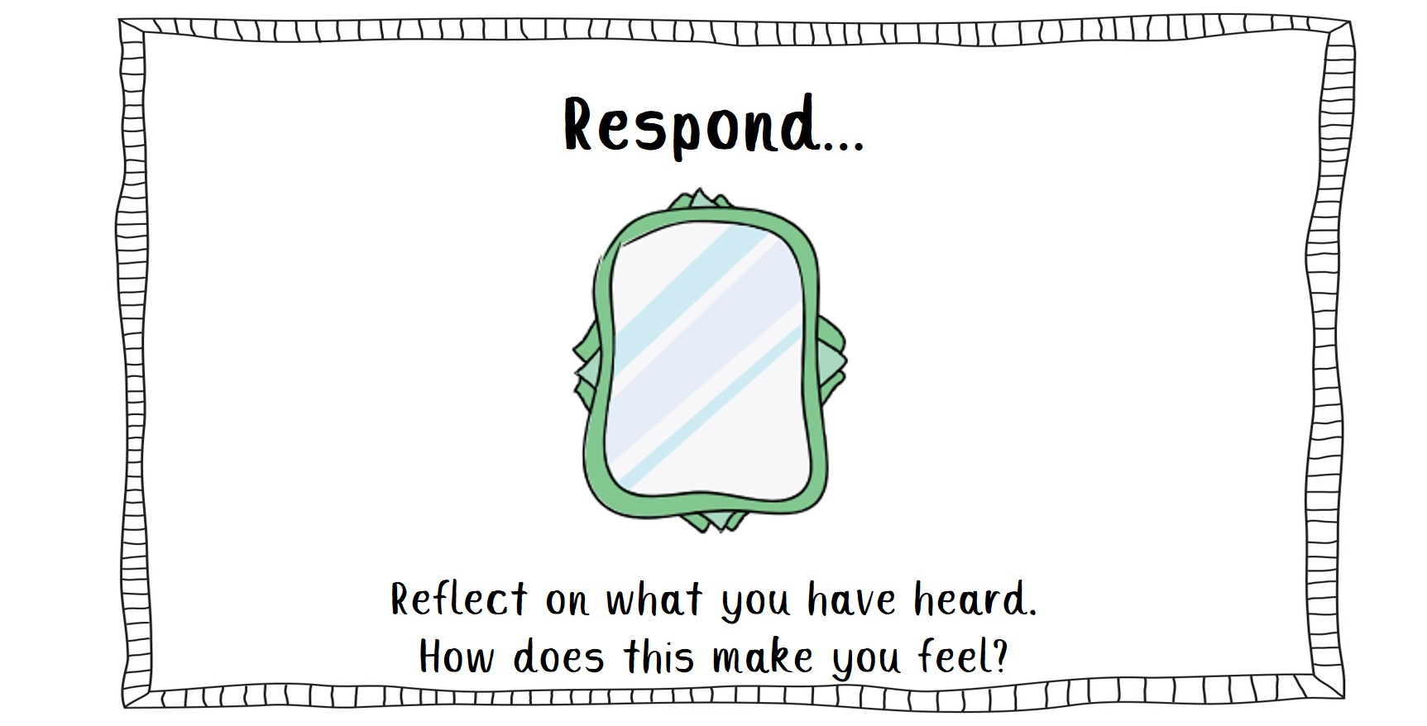

Slide 9

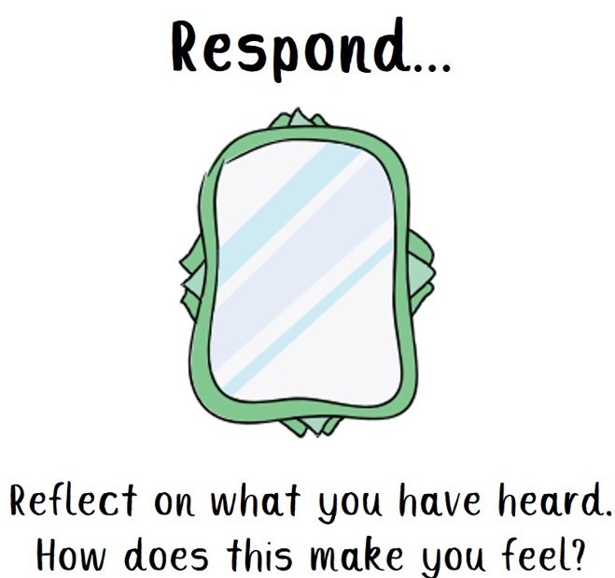
Christians believe that God made the Northern lights.
What BIG questions might you ask God about his creation to find out more about Aurora Borealis?

Slide 10

My turn,
My big question is: God, how are there so many different colours?

Slide 11
Your turn,
My big question is: ……………

Slide 12
https://www.youtube.com/watch?v=PgIKsuZ3RZU
Let’s see if any of your big questions can be answered here:

Slide 13
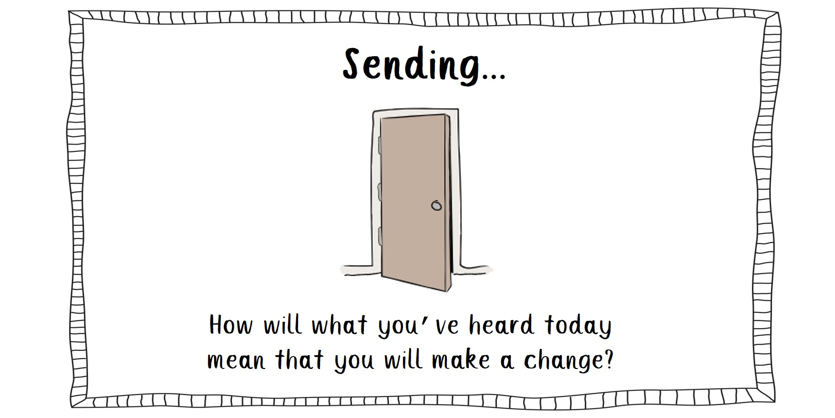

Slide 14
How can you look at God’s creation and experience ‘awe and wonder’ this week?

Slide 15

An invitation to pray…
Did you know that each time we pray, we’re making a connection with God?
Who would like to think of a prayer to thank God for his creation today?

Slide 17

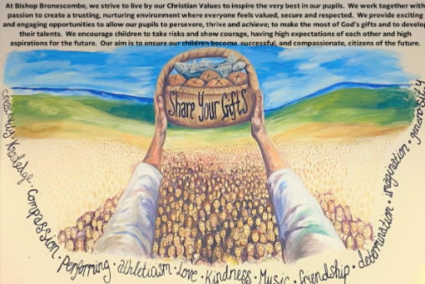
God be with you

